Slide 1
Three-year savings and transformation opportunities

Slide 2
The National Savings Opportunity with Liaison Group
£692m
Savings Opportunity £11.9bn
Savings Delivered.
24/25
Last three years
Next three years
From this,
NHS England’s opportunity:
£9.9bn

Slide 3
Story of the last three years
Innovating to address national challenges, including:
CHC spend
Backlogs
Use of Fast Track
Recruitment spend freeze
Candidate retention and engagement
Productivity
Waiting Lists
Medicines spend
Visibility
Monopoly over NHS rostering
Visibility and ability to triangulate data
Existing tech capabilities
Waiting Lists
Agency spend
Workforce capacity
Agency spend

Slide 4
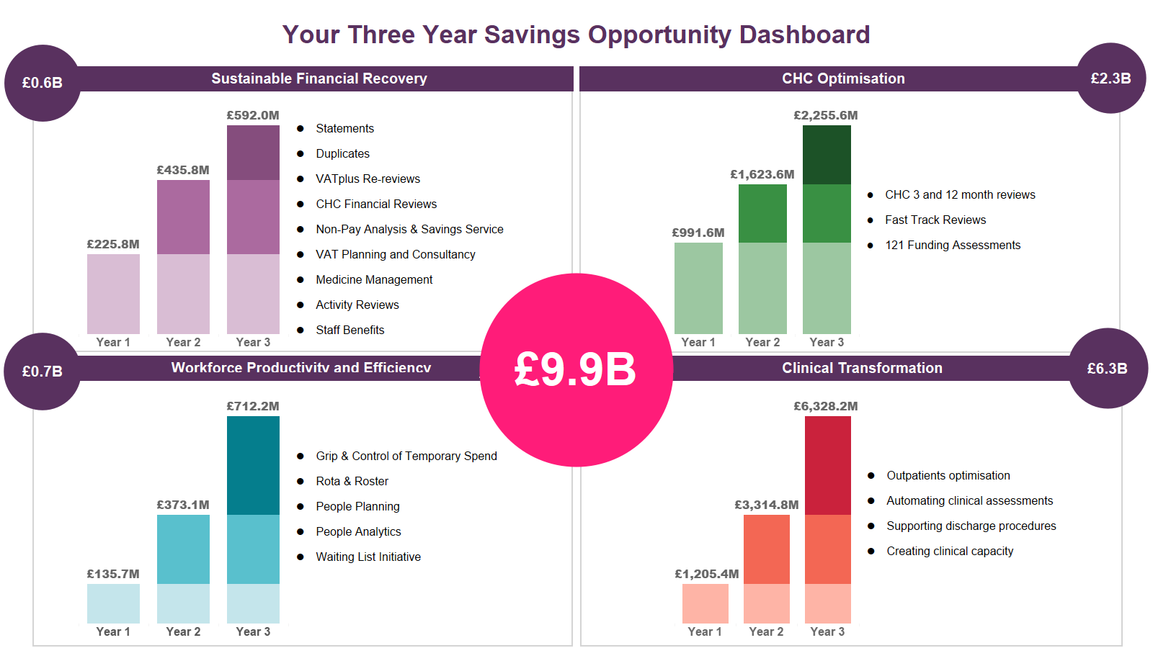

Slide 5
Our Clients...

Slide 6
Delivering transformation across four key areas of the NHS
Delivering transformation across four key areas of the NHS
The Challenge
Our Solution
Outcomes Delivered
Success Stories
Savings in non-pay spend of £217m in 2023
£135m saved via our VATflow service alone
Average savings of £320k per org with VATplus Re-review service
Financial recovery for 35 years, working with 72% of the NHS
“The team are extremely knowledgeable, assurance that all areas have been reviewed and all VAT efficiencies have been maximised. As a result,
they identified
£325,000.”
NHS Financial Deficit
Grip and control
1
Financial Recovery
Programme
Reduced Agency Bill by 20 - 25%
Increasing average bank fill rates to 53%
Saving 42 working days per organisation per year in invoice processing admin
Increased workforce productivity for 104 NHS organisations
Walsall Healthcare NHS Trust achieved a 41% reduction in monthly agency spend, increasing bank fill from 30% to 66% and delivered
annualised savings of
over £3millon.
Paybill and Agency overspend
High WTE
Poor productivity
2
Workforce Productivity and Efficiency Journey

Slide 7
Delivering transformation across four key areas of the NHS
Delivering transformation across four key areas of the NHS
The Challenge
Our Solution
Outcomes Delivered
Success Stories
Average efficiencies of 15 - 30% per case load
Care packages rightsized through clinical-led reviews - 4,800 case reviews to date, with £46m savings delivered
Partnering with over 30% of ICBs
“I’ve found it to be a great experience working with Liaison Care, who clinically reviewed our backlog of CHC cases. I have found them to be knowledgeable,
responsive and
capable.”
Need for high quality services focussed on delivering the right package of individualised care
3
CHC Optimisation Solutions
Poor patient flow and productivity
Need for true hospital at home solution
Increased demand from patients without bed space in hospital
Discharging patients 5 days sooner with over £5m costs saved
43% capacity increase
Saves 20,000 bed days in a year
100 patients at any one time in hospital at home
Own bed is best bed
“It has helped us to manage our caseload safely and efficiently and support more patients to recover in their own home. This helps to free up beds for patients who need to receive treatment in
hospital.”
4
Clinical Transformation Approach

Slide 8
Over to you

Slide 10
Our People
Our Processes
Our Tech
I would just like to provide some feedback on Natalie Tudor during the DE implementation process:
Natalie’s energy and enthusiasm has driven this project – without her I don’t think we would be anywhere near starting up with DE so quickly. Nothing is too much trouble for Nat; she always volunteers for those difficult jobs and goes above and beyond what could reasonably be expected Natalie has been extremely supportive during this time and is always available for a call at very short notice. Natalie shows great initiative and a “can-do” attitude that is a credit to her and Liaison as her employer.
There was some organisational nervousness about outsourcing reviews, but the quality of services and ability to flex to meet Welsh requirements has been outstanding with a focus at all times on clinical quality not finances.
The Liaison processes are efficient, comprehensive and well documented with several families taking time to comment on their caring approach in remote reviews to ensure the patient/ family voice is heard and recorded fully. When dealing with complex clinical cases clinical grey areas are inevitable in a few cases: I have been really pleased and impressed with how individual cases and partnership working with us has been undertaken to ensure the individual is fairly and equitable at the centre of all decisions.
As a department, we can see the full benefits of the new system. Through fully utilising the outsourcing function, we now have better oversight and understanding of our rota gaps and locum spend. This, paired with our new safe staffing level guide, has resulted in a reduction of our locum use from 10.4 WTE to 5.2 WTE in just 8 weeks – an overall saving of around £30,000 per month.
The main driving factor for this improvement is the visibility that NHS at Work offers, with the outsourcing function allowing it to interact with TempRE. As the system has allowed us to reduce our need for locums, we have also seen a quicker uptake of shifts, more than halving the average time it takes to fill a locum shift to 52 hours.
Richard Williamson
Senior Procurement Category Manager (Workforce)
Catrin Fear
Operations and Performance Manager,
Emergency Medicine
Head of CHC Commissioning

Slide 11
Our approach
Our focus is on true partnership over transactions. With Liaison Group you can expect:
Each of our 385 NHS experts has a shared passion – to help create the best NHS for themselves and their loved ones.
That’s just one of the reasons we take the risk of offering our services on a savings-contingent arrangement.
Collaboration
Shared Vision
True Partnership
Commitment to Improving Patient Care
Start your savings journey with Liaison Group today.
Contact your Account Manager or get in touch at LiaisonGroup.com

